Slide 1
Developmental Disabilities Technology’s Role in Addressing Gaps in Support
June 21, 2018
Leslie Meczka
VP, National Accounts

Slide 2
Who We Are
Founded in 2007, Rethink is a leading Health Technology Company based in New York City
Experienced team of clinicians and special educators with decades of experience
Education
Employee Benefits
Behavioral Health
School districts worldwide
US Department of Defense for military base school system worldwide
Small to larger employers through benefits/health and wellness plans
Benefits consultants, PEOs, TPAs
Public and private behavioral health providers
Managed Care Organizations
Notes:
BH division handles Billing, patient management, and reconciliation.
Really our mission across all 3 divisions is the same, which is the empower those with developmental disabilities.

Slide 3
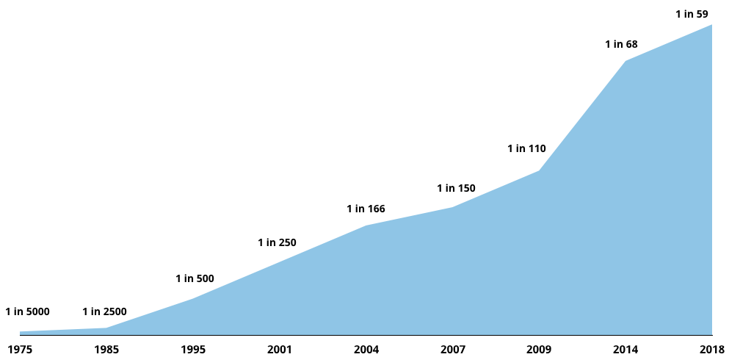
Explosion in Developmental Disabilities
17%
of children have a Developmental
Disability
Autism (1.5%)
Developmental Delays
Intellectual or Learning Disabilities
Speech / Language Problems
ADD/ADHD
Down Syndrome
Problem Behaviors
1 in 6
Children have a Developmental
Disability
1 in 6
Children have a Developmental
Disability
$60,000+
Average annual treatment cost per individual
Source: CDC Data and Statistics, www.cdc.gov.

Slide 4
Severe Global Shortage of Therapists
450M
Children with a developmental disability (birth to age 21)
1 Therapist
for every 18,000 children
25K
Behavioral Therapists
Sources: CDC Data and Statistics, www.cdc.gov, Population Reference Bureau, 2016.

Slide 5
Employee Challenges
Who can help my child with a developmental disability?
What is the right treatment approach?
How do I work with my child’s school and caregivers?
Is there anything I can do now?

Slide 6
Impact on Employees and Employers
Of caring for a child with a developmental disability:
Higher Rates of Anxiety and Depression
Increased Absenteeism and Lost Productivity
Heavy
Impact on Employment Decisions
Significantly Higher Health Care Costs
2.4X
Increase in mental health issues
250
Hours of lost work time
50%
Worked fewer hours/did not take job
2X
The cost of medical care
Sources: PEDIATRICS: Psychological Functioning and Coping Among Mothers of Children with Autism, Montes & Halterman, 2007. National Business Group on Health: Therapies for Children with Autism Spectrum Disorders, May 2012. Social Science Journal: Concentration of Adverse Employment Effects on Mothers with Children with Autism, Baker & Drapela, Jan 2010
Notes:
These stats come from NBGH, CDC, and a number of other studies to help you better understand the business case or how to present this internally. It’s not a clear ROI or claims analysis for this population.
We instead take the approach of…
These are just highlights, but should you need deeper supports or help presenting the business case downline, we are happy to support you with materials and concise pieces that can help here.

Slide 7
Gaps in Support Span All Medical Plans
Rethink supports employees where medical plan & EAP’s cannot
+
Oriented to Patient Only
Critical Gaps in Plan
Patient Care + Critical Caregiver Supports
Work | School | Family | Therapist
Medical Plan | Medical Plan + Rethink
Severely limited supply of therapists. Long wait times (6-18 months on average.) | Available pre-diagnosis (as medically recommended) as well as post-diagnosis online 24/7 with no wait times.
Only eligible for Autism diagnoses — 1 in 68. | Available for all developmental disabilities or 1 in 6 (Autism, ADD/ADHD, Down Syndrome, Learning Delays, etc.)
Age limitations for medical eligibility and not available for employees/dependents unenrolled in plan. | Available for all employee dependents regardless of age and/or medical plan eligibility.
Lack of caregiver training and supports. | Provides scalable caregiver training and supports.
Lack of supports for non-medical issues such as school system. | Provides supports for non-medical issues such as school system.

Slide 8
The Rethink Solution
Innovative solution, providing employees and their families with 24/7 accessible e-learning tools, best practice clinical supports, and a BCBA clinician throughout the year for 1:1 training.
Video Based Training
Coordination of Care
Automated Progress Tracking
Peer Support & Online Resources
Remote Consultation
Personalized consultations for the caregiver throughout the year with a Board Certified Behavior Analyst (BCBA) – training them with strategies and tips to address problem behaviors, teach and develop their child.
Comprehensive e-learning platform with over 1,500 video-based “how-to” lessons.
Customized for the dependent and available 24/7 in the home to manage treatment & care
Web-based and mobile availability fosters real-time communication and coordination among care team members
Tools to track the dependent’s progress in real time & utilization reporting for employers
Provides encouragement and support through online communities and forums
Access to printable resources, webinars, tips, news & more

Slide 9
Best Practices for Holistic Employee Support
Introduce & cross train your vendor ecosystem to ensure all possible employee touchpoints are educated – thereby reducing navigation
Employer
Rethink
EAP
Health & Wellness Vendors
Health Plan
Employees can access the Rethink program directly and/or through employer’s corporate wellness portal, wellness site, etc.
Health plan refers employee to Rethink program. Rethink trains health plan staff on platform and referral process. Rethink refers employee to Health Plan where appropriate
EAP refers employee to Rethink program. Rethink trains EAP staff on platform and referral process Rethink refers employee to EAP where appropriate
Health & Wellness vendor refers employee to Rethink program. Rethink trains staff on platform and referral process. Rethink refers employee to Health Advocacy org. where appropriate

Slide 10
Business Case for Supporting Caregivers
Proven Effectiveness of Parent Training vs. Education
High Employee Cost of Doing Nothing
Increases
Care Quotient
Positions Company as “Employer of Choice”
Parents with training see 60% reduction in problem behavior vs. 35% for only education
Rethink is the industry’s only parent training platform
2.4X increase in mental health issues
250 hours lost productivity
2X higher medical costs
Lack of supports in home increases behavioral problems and safety issues
Many employees feel stigma so won’t self-identify
Sends clear message to entire employee population that their employer supports individuals with special needs
Drives goodwill among both employees and customers
Offering a robust system of care for both employees AND their families positively impacts recruitment & retention
Especially critical for caregivers of individuals with special needs
“Any vendor can make the numbers work to prove some sort of ROI. At Costco, we are extremely selective with choosing our vendors and look deeper than ROI calculators to truly understand what services are going to provide the most impact to our Associates. Rethink was a no-brainer.”
Donna Sexton - Director of Benefits, Costco Wholesale
Notes:
In behavioral health in general there really is no clear ROI, and

Slide 11
User Feedback
Collected via user site submissions | Fall 2017
Facebook: “There's little professional support for working parents and you end up looking on the internet or asking others. It often leaves you more confused than not. Rethink makes me save time and find reliable sources. This removes stress from my everyday life so I can focus on the other important component of my daily life like work.”
PayPal: “I love her progress with eye contact and social interaction! She has been much more affectionate and holds eye contact for as long as any other child. Special needs children are expensive, frustrating, scary and hard to understand. This program helped me be a better parent to my daughter's needs, which relieved a lot of stress and anxiety.”
Activision Blizzard: “I think it is pretty amazing… ABA waitlists sometimes can be up to a year and this was paramount in my daughter's progress while we waited for a Therapist through insurance”
Amazon: “I was struggling myself to help my son adjust to a new school environment. I felt like I was failing him as a parent. Rethink empowered me with a new approach to my son’s issue.”
Home Depot: “I like that my employer cares about kids and families with special needs. It makes me feel they are more understanding about some of the challenges that families they employ are faced with.”
Starbucks: Every employer should have this available to their employees. Having a child with special needs is very challenging - to have one without many resources is even more challenging. This tool shows the employee you care about on more than just a “what does this employee do for me” level. It will also help alleviate some stress which would in turn increase production levels.

Slide 12
Adulthood: Neurodiversity & Its Importance
Neurodiversity includes neurological conditions such as autism spectrum disorder, developmental delays, ADHD, social anxiety disorders, dyslexia, etc.
Much like there are advantages gained from having employees that span many diverse backgrounds, cultures, genders, etc - those with a neurodiverse condition have much to offer.
Because neurodiverse individuals are wired differently from “neurotypical” people, they are more direct, and can bring new perspectives to a company’s efforts to create or recognize value.

Slide 13
Current Market Situation
Neurodiverse individuals bring strong skills and talents to markets that currently have a shortage of workers. The neurodiverse population is an untapped talent pool with unemployment as high as 80%.
Neurodiverse individuals excel in:
Data analytics and IT services
Pattern recognition
Memory
Mathematics
800,000
Estimated shortage of IT workers by 2020 in the EU.
Notes:
80% of adults w/ Autism w/ a 4 year degree are unemployed

Slide 14
Challenges Hiring Neurodiverse Individuals
Interviewing is a weak point
Poor eye contact
Prone to conversational tangents
Overly honest about weaknesses
Confidence problems
Need to adjust individual work contexts and allow deviation from established practices
Difficult for managers at large companies to sift away from compliance through standardization
Need for managers to tailor individual work settings

Slide 15
The Case for Neurodiversity
Productivity
Gains
Quality
Improvement
Boost
Innovation
Increase
Engagement
Join Leading
Brands
Up to 30% more productive.
(Results from Australia’s Department of Human Services.)
Superior results spotting patterns.
(Israeli Defense Forces Special Intelligent Unit)
Access to more talent.
Diverse perspectives help companies solve problems and become more effective competitors.
Reputational benefits as good corporate citizens.
Neurodiversity is embraced by leading brands such as; SAP, HP, Microsoft, Willis Towers Watson, and Ernst & Young.

Slide 16
A Successful Neurodiversity Program
Assessment
Process
Experienced
Teams
Organization
Training
Support
System
Use non-interview assessment processes.
SAP & HP use comfortable gatherings to allow candidates to demonstrate abilities in casual interactions.
Team with experienced organizations.
Organizations experienced in working with neurodiverse individuals can help provide access to and ongoing training of the right candidates.
Train colleagues and managers in what to expect.
Help neurotypical employees understand neurodiversity and the need to accommodate properly.
Manager training in supporting neurodiverse employees.
Establish a proper support system.
Workplace supports for neurodiverse employees and managers.
Home supports for the employee’s family.

Slide 17
How Rethink Can Help
E-Learning
Modules to train managers and neurotypical employees
Support
Clinical support system to help neurodiverse employees
Understanding neurodiversity.
Adopting a management style to help neurodiverse employees succeed.
Improving and clarifying communication.
Identifying and addressing issues before they escalate.
Remote consultation with trained clinicians for managers and neurotypical and neurodiverse employees and their families:
Address challenges in real-time and provide strategies for success
Reinforce work-place solutions at home

Slide 18
Rethink Neurodiversity Training Center
E-Learning to improve awareness and job productivity for all employees.
Features, content and interface are designed for effective e-learning and flexible options for implementation.
Engaging Video Modules
Short and Easy (5-10 minutes)
Focus on employee strengths and abilities
Practical strategies
Proactive
Web-based training is OS and hardware agnostic.

Slide 19
Rethink Neurodiversity Training Center
Active Participation
Guided notes
Short review quizzes
Discussion guides
Materials and Resources
Accompanying printables to implement strategies; checklists, visual cues, etc.
Follow-Up Activities
Guides for self-reflection
Additional reading and research content

Slide 20
Thank you
Contact Leslie Meczka
Leslie.Meczka@rethinkbenefits.com | (440) 662.8397
www.RethinkBenefits.com

