Slide 1
Color me surprised
Understanding How employees make choices at open enrollment
Mason Shea, FSA, MAAA, FCA
Principal
Richmond

Slide 2
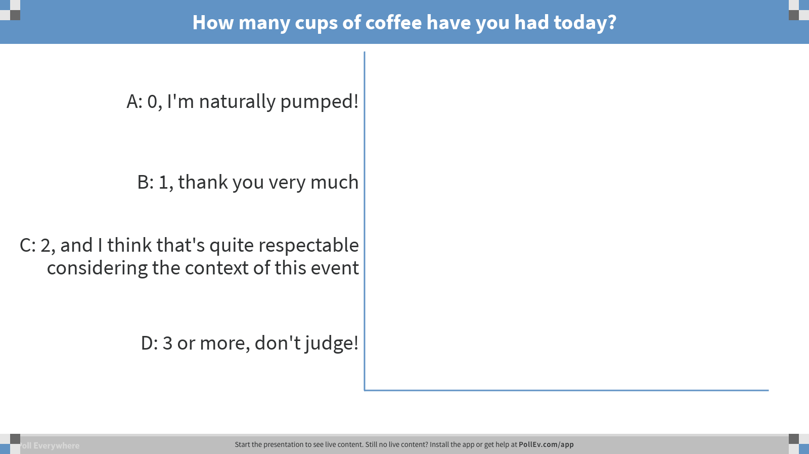
Notes:
Poll Title: How many cups of coffee have you had today?
https://www.polleverywhere.com/multiple_choice_polls/Elm6KkchlHeqKLR

Slide 3


What is Behavioral Economics?
Framing Effects
Information Friction
Search Cost
Case Study
Status Quo Bias

Slide 4

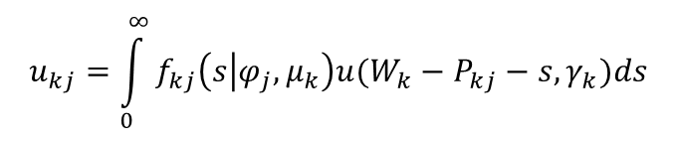
What is Behavioral economics?
Recognition of the gap between “homo economicus” ….. and homo sapiens
How do we really make decisions?
  Is different depending on the decision
  We take shortcuts
$$u_{kj}=\int_{0}^{∞}{f_{kj}\left(s | φ_{j},μ_{k}\right)u(W_{k}−P_{kj}−s,γ_{k})ds}$$

Slide 5
Information frictions

Slide 6
Information frictions
…And an aside on healthcare literacy
Misperceptions or misunderstandings can prevent good decision-making
  But the starting point here is healthcare…!
A 2014 Kaiser Family Foundation Study found the following:
In addition, many people equate cost with quality in healthcare
With these results as our baseline, what’s the likelihood of success for more complex healthcare strategies?
Questions | % Correct | Common Incorrect Answer
Definition of “health insurance premium” | 76% | Don’t Know (16%)
Definition of “annual health insurance deductible” | 72% | Don’t Know (15%)
Definition of “annual out-of-pocket limit” for a health policy | 67% | Don’t Know (18%)
Definition of “health insurance formulary” | 33% | Don’t Know (53%)
Simple calculation of expected out-of-pocket costs | 16% | $80 (39%)
Questions | % Correct | Common Incorrect Answer
Definition of “health insurance premium” | 76% | Don’t Know (16%)
Questions | % Correct | Common Incorrect Answer
Definition of “health insurance premium” | 76% | Don’t Know (16%)
Definition of “annual health insurance deductible” | 72% | Don’t Know (15%)
Definition of “annual out-of-pocket limit” for a health policy | 67% | Don’t Know (18%)
Questions | % Correct | Common Incorrect Answer
Definition of “health insurance premium” | 76% | Don’t Know (16%)
Definition of “annual health insurance deductible” | 72% | Don’t Know (15%)
Definition of “annual out-of-pocket limit” for a health policy | 67% | Don’t Know (18%)
Definition of “health insurance formulary” | 33% | Don’t Know (53%)
Questions | % Correct | Common Incorrect Answer
Definition of “health insurance premium” | 76% | Don’t Know (16%)
Definition of “annual health insurance deductible” | 72% | Don’t Know (15%)

Slide 7
Information frictions
…so what do we do?
Beware the “curse of knowledge”
Find ways to strip things down for clarity
  Do not include things because they have always been included
  Do not include things that aren’t significant
Provide OOP cost estimates using simple examples
If using online enrollment, provide links or videos in-site explaining basics

Slide 8
Status quo bias

Slide 9
Status quo bias
”to do nothing is within every man’s power” – samuel johnson
We have a tendency to stick with the current or previous decision, even above what would normally be expected
  This tendency increases with the number of choices presented
Could be caused by
  Self-perception (“good enough for me then, good enough for me now”)
  Avoidance of decision regret

Slide 10
Status quo bias
…so what do we do?
Compare current vs. new employee choices
Passive vs. active enrollment
No defaults (“smart” defaults?)

Slide 11
Framing effects

Slide 12
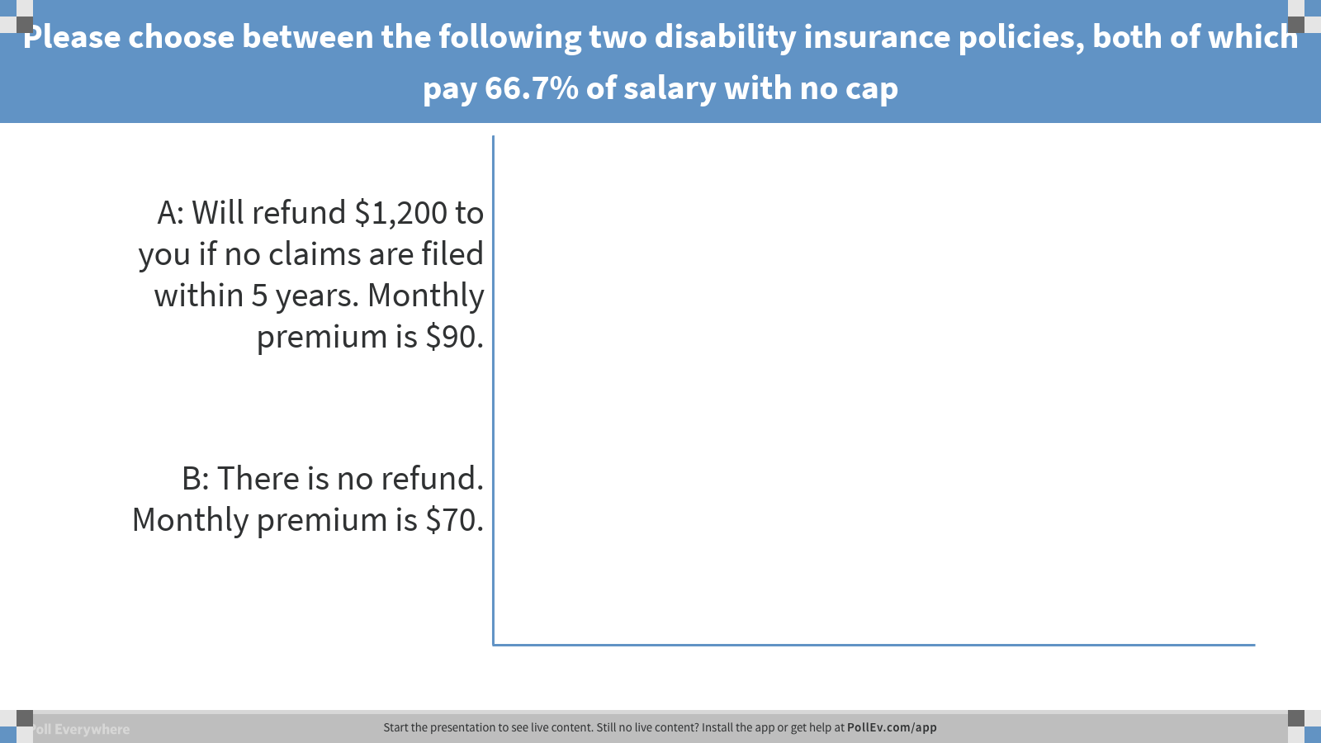
Framing effects
pop quiz!
Notes:
Poll Title: Please choose between the following two disability insurance policies, both of which pay 66.7% of salary with no cap
https://www.polleverywhere.com/multiple_choice_polls/IWolfTArwbVY5rT

Slide 13
Framing effects
pop quiz!
Please choose between the following two disability insurance policies, both of which pay 66.7% of salary with no cap
  A: Will refund $1,200 to you if no claims is filed within 5 years. Monthly premium is $90.
  B: There is no refund. Monthly premium is $70.
 | No Claims | 1 week | 5 Weeks | 10 weeks
Policy A
Benefit | $0 | $500 | $2,500 | $5,000
Premium | $5,400 | $5,400 | $5,400 | $5,400
Refund | $1,200 | $0 | $0 | $0
Net Impact | ($4,200) | ($4,900) | ($2,900) | ($400)
 | No Claims | 1 week | 5 Weeks | 10 weeks
Policy A
Benefit | $0 | $500 | $2,500 | $5,000
Premium | $5,400 | $5,400 | $5,400 | $5,400
Refund | $1,200 | $0 | $0 | $0
Net Impact | ($4,200) | ($4,900) | ($2,900) | ($400)
Policy B
Benefit | $0 | $500 | $2,500 | $5,000
Premium | $4,200 | $4,200 | $4,200 | $4,200
Refund | $0 | $0 | $0 | $0
Net Impact | ($4,200) | ($3,700) | ($1,700) | $800
 | No Claims | 1 week | 5 Weeks | 10 weeks
Policy A
Benefit | $0 | $500 | $2,500 | $5,000
Premium | $5,400 | $5,400 | $5,400 | $5,400
Refund | $1,200 | $0 | $0 | $0
Net Impact | ($4,200) | ($4,900) | ($2,900) | ($400)
Policy B
Benefit | $0 | $500 | $2,500 | $5,000
Premium | $4,200 | $4,200 | $4,200 | $4,200
Refund | $0 | $0 | $0 | $0
Net Impact | ($4,200) | ($3,700) | ($1,700) | $800
Difference (A – B) | $0 | ($1,200) | ($1,200) | ($1,200)

Slide 14
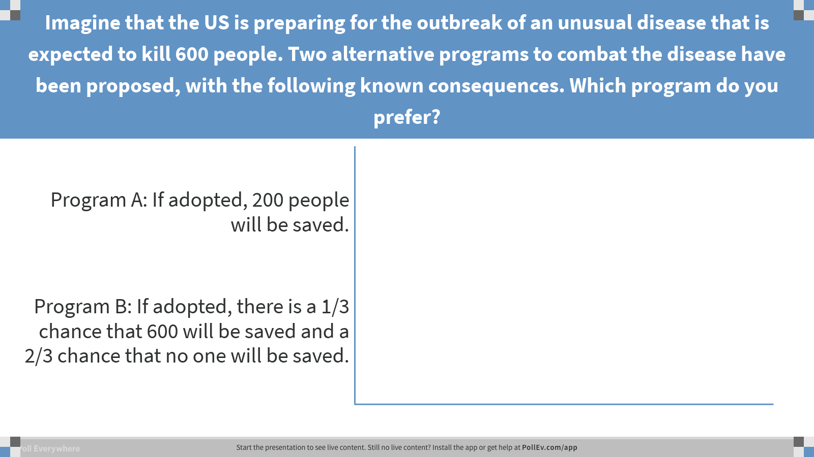
Framing effects
pop quiz!
Notes:
Poll Title: Imagine that the US is preparing for the outbreak of an unusual disease that is expected to kill 600 people. Two alternative programs to combat the disease have been proposed, with the following known consequences. Which program do you prefer?
https://www.polleverywhere.com/multiple_choice_polls/GkngNoKOvmtZmnf

Slide 15
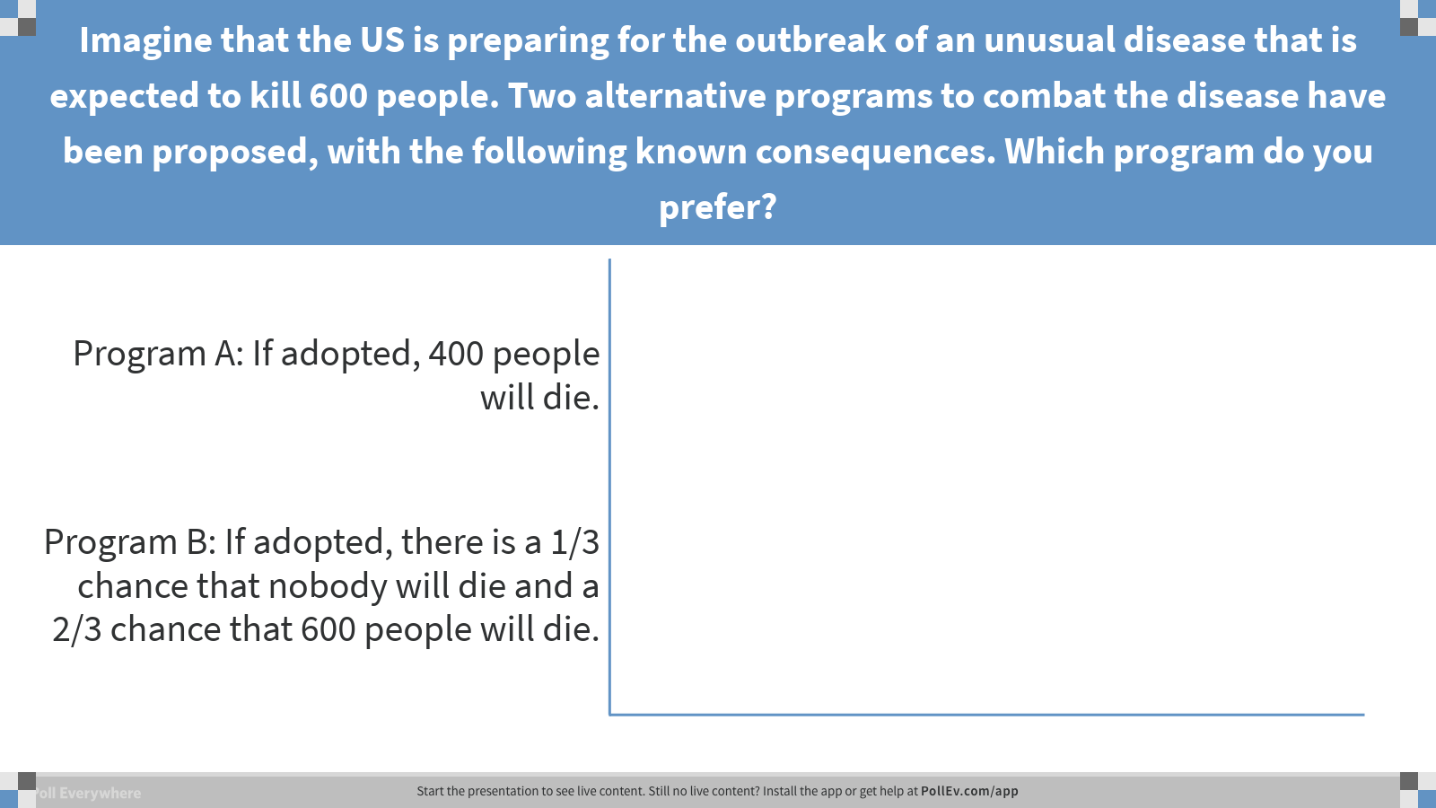
Framing effects
pop quiz!
Notes:
Poll Title: Imagine that the US is preparing for the outbreak of an unusual disease that is expected to kill 600 people. Two alternative programs to combat the disease have been proposed, with the following known consequences. Which program do you prefer?
https://www.polleverywhere.com/multiple_choice_polls/fujyDqGC6fMtjtm

Slide 16
Framing effects (Cont)
How a problem is framed shouldn’t affect someone’s ability to choose…
…but it does
 | No Claims | $200 | $600 | $1,000
Policy A – Deductible frame
Benefit | $0 | $0 | $0 | $400
Premium | $1,000 | $1,000 | $1,000 | $1,000
Net Impact | ($1,000) | ($1,000) | ($1,000) | ($600)
 | No Claims | $200 | $600 | $1,000
Policy A – Deductible frame
Benefit | $0 | $0 | $0 | $400
Premium | $1,000 | $1,000 | $1,000 | $1,000
Net Impact | ($1,000) | ($1,000) | ($1,000) | ($600)
Policy B – rebate frame
Benefit | $600 | $400 | $0 | $0
Premium | $1,600 | $1,600 | $1,600 | $1,600
Net Impact | ($1,000) | ($1,200) | ($1,600) | ($1,600)
 | No Claims | $200 | $600 | $1,000
Policy A – Deductible frame
Benefit | $0 | $0 | $0 | $400
Premium | $1,000 | $1,000 | $1,000 | $1,000
Net Impact | ($1,000) | ($1,000) | ($1,000) | ($600)
Policy B – rebate frame
Benefit | $600 | $400 | $0 | $0
Premium | $1,600 | $1,600 | $1,600 | $1,600
Net Impact | ($1,000) | ($1,200) | ($1,600) | ($1,600)
Difference (A – B) | $0 | $200 | $600 | $1,000
44%
68%

Slide 17
Framing effects (Cont)
The effects are pervasive – consider the following study of doctors reacting to two different treatments for lung cancer
 | Survival Frame (% alive)
Treatment Options | Radiation | Surgery
After Treatment | 100% | 90%
After 1 Year | 77% | 68%
After 3 Years | 22% | 34%
 | Survival Frame (% alive)
Treatment Options | Radiation | Surgery
After Treatment | 100% | 90%
After 1 Year | 77% | 68%
After 3 Years | 22% | 34%
% Choosing | 18% | 82%
 | Survival Frame (% alive) |  | Mortality Frame (% dead)
Treatment Options | Radiation | Surgery | Radiation | Surgery
After Treatment | 100% | 90% | 0% | 10%
After 1 Year | 77% | 68% | 23% | 32%
After 3 Years | 22% | 34% | 78% | 66%
 | Survival Frame (% alive) |  | Mortality Frame (% dead)
Treatment Options | Radiation | Surgery | Radiation | Surgery
After Treatment | 100% | 90% | 0% | 10%
After 1 Year | 77% | 68% | 23% | 32%
After 3 Years | 22% | 34% | 78% | 66%
% Choosing | 18% | 82% | 46% | 54%
 | Survival Frame (% alive) |  | Mortality Frame (% dead) |  | Both Frames
Treatment Options | Radiation | Surgery | Radiation | Surgery | Radiation | Surgery
After Treatment | 100% | 90% | 0% | 10%
After 1 Year | 77% | 68% | 23% | 32%
After 3 Years | 22% | 34% | 78% | 66%
% Choosing | 18% | 82% | 46% | 54% | 40% | 60%

Slide 18
Framing effects
…so what do we do?
In what order are your plans listed?
What are the plans called?
  Beware of names like “premium” and “value”

Slide 19
Search cost

Slide 20
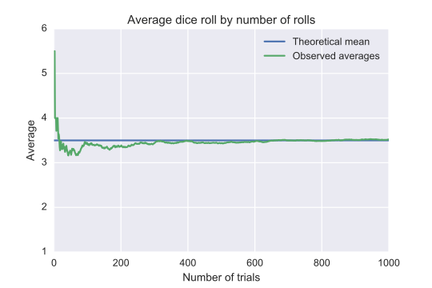
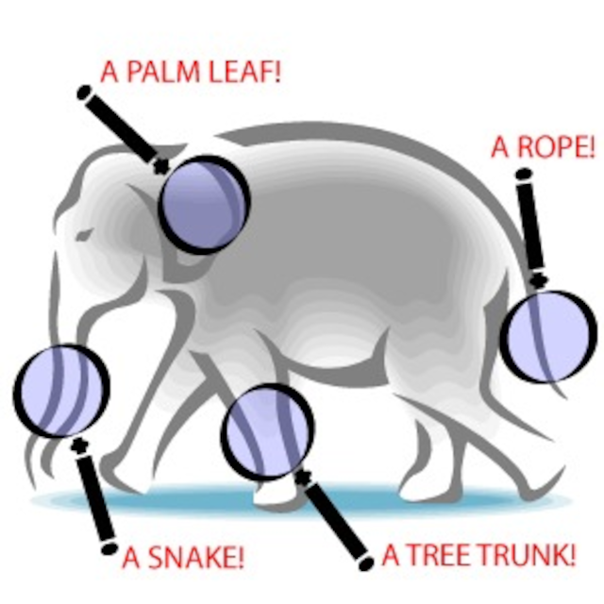
Search cost
Don’t make people think too hard
The time and effort it takes for someone to try to make the optimal decision can be considered a cost
  From this perspective, we want our decisions to come as cheaply as possible, otherwise people will give up or revert back to the status quo
“Law of small numbers”
So in general, we should consider “cognitive effort” as something to avoid presenting at open enrollment

Slide 21
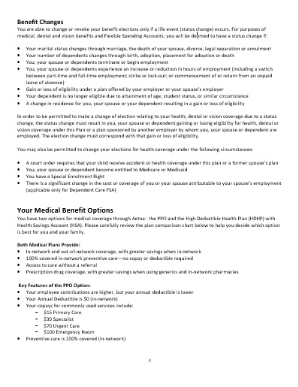

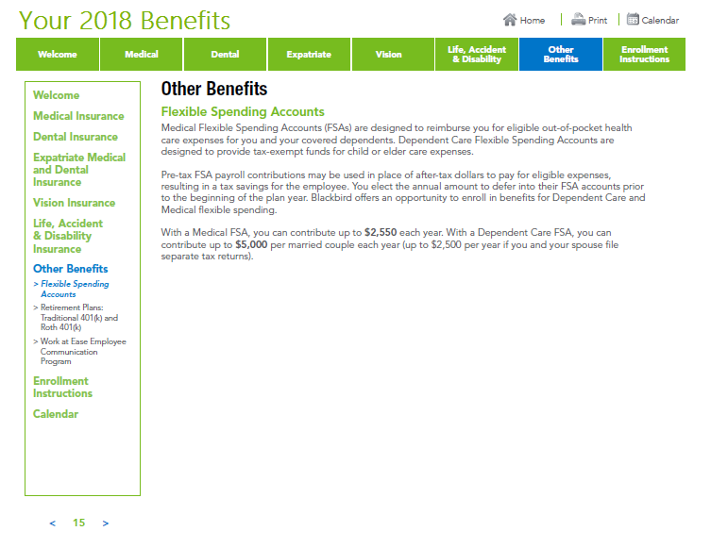
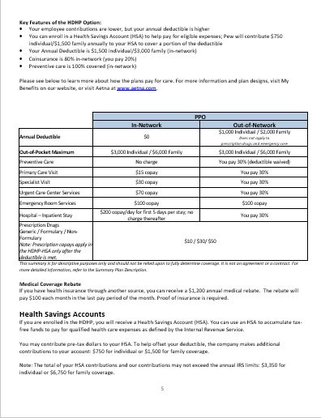
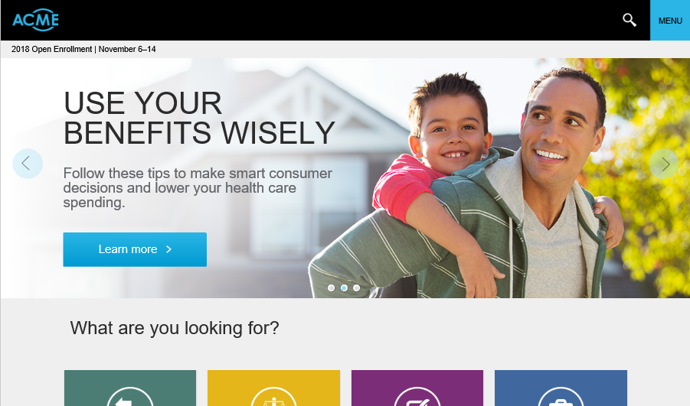
Search cost
…so what do we do?
Open enrollment materials that are summarized in one spot are great
  Searchable/clickable could be even better

Slide 22
Optimized open enrollment experience
A case study

Slide 23
Optimized enrollment experience
What does it look like?
Nudges
No defaults, or smart defaults
Links or in-site videos or brief descriptive definitions
OOP Calculator, or simple examples of plan cost sharing
Ability to sort and filter, where applicable
And now….an example

Slide 24
Choice architecture matters
What is Behavioral Economics?
Framing Effects
Information Friction
Search Cost
Case Study
Status Quo Bias

Slide 25
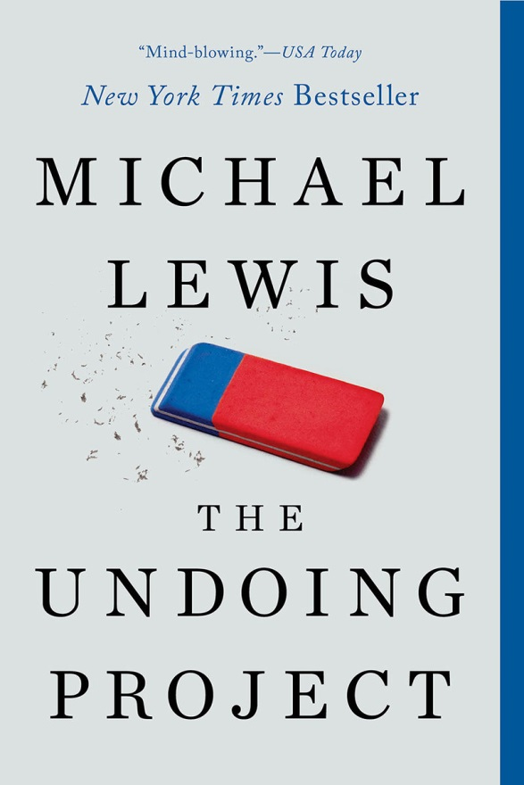
Inspiration & references
Michael Lewis’ “The Undoing Project”
Also:
  “Consumer Decisionmaking in the Health Care Marketplace”, Eibner et al,
  RAND Research Report, RAND corporation, 2016
  “Status Quo Bias in Decision Making”, Samuelson, W.; Zeckhauser, R.,
  Journal of Risk and Uncertainty, 1988
  “Framing, Probability Distortions, and Insurance Decisions”, Johnson et al,
  Journal of Risk and Uncertainty, 1993
  “Individual Decision Making”, Camerer, C., Chapter 8 in Kagel, J., and A.
  Roth (eds) Handbook of Experimental Economics, 1995
  “Health Insurance for “Humans”: Information Frictions, Plan Choice, and
  Consumer Welfare”, Handel, B.; Kolstad, J., American Economic Review, 2015
  “Assessing Americans’ Familiarity with Health Insurance Terms and Concepts”, The Henry J. Kaiser Family Foundation, 2014

